Slide 1
OO Design Patterns
Coding Cleverly
Notes:
<number>

Slide 2
Why design pattern
Design patterns make code :
Reusable
Common building blocks most programmers know
Add functionality in the simplest way
See Repository for code examples!
Notes:
<number>

Slide 3
Types of Design patterns
Creational
Create objects but hide details of constructors
Structural
Concern composition, aggregation, inheritance
Behavioral
Concerning interfaces between objects

Slide 4
Today’s Agenda
Observer
Strategy
Factory
Decorator
Adapter
Singleton
Proxy
Patterns we will cover

Slide 5
Observer
Problem:
There is a one to many relationship where the many need to know information from the one. Is it scalable for many to be polling the one?
Example: Think of designing push notifications on mobile phones
Notes:
<number>

Slide 6
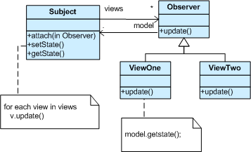
Observer
Notes:
<number>

Slide 7


Observer
Notes:
<number>

Slide 8
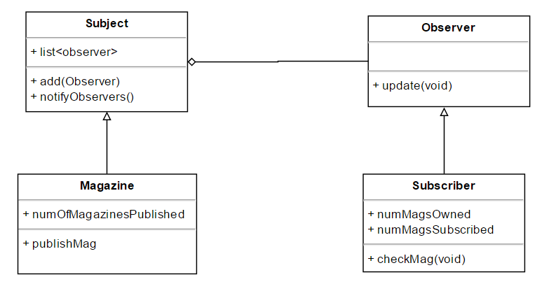
Observer
Notes:
<number>

Slide 9
Strategy
Problem:
The same object needs to have different behaviours at different times when running the program
Notes:
<number>

Slide 10
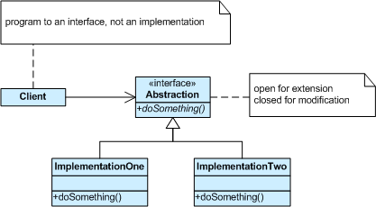
Strategy
Notes:
<number>

Slide 11
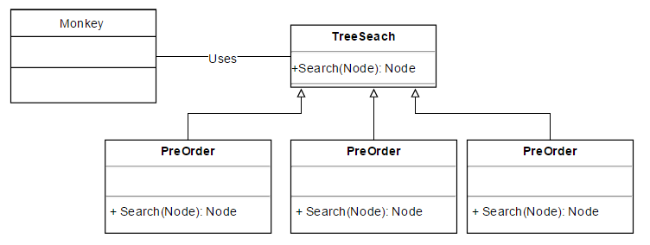
Strategy
PreOrder
InOrder
PostOrder
Notes:
<number>

Slide 12
Factory
Problem:
How can we create objects at runtime without cluttering code with many if else statements
Notes:
<number>

Slide 13
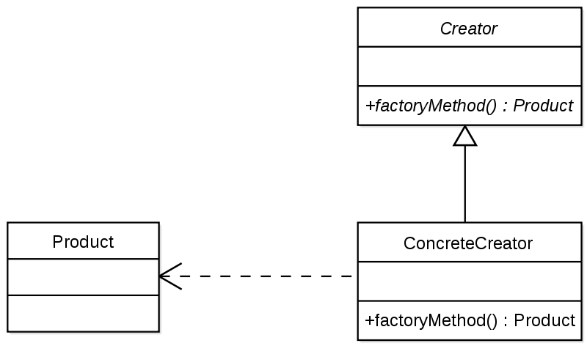
Factory
Notes:
<number>

Slide 14
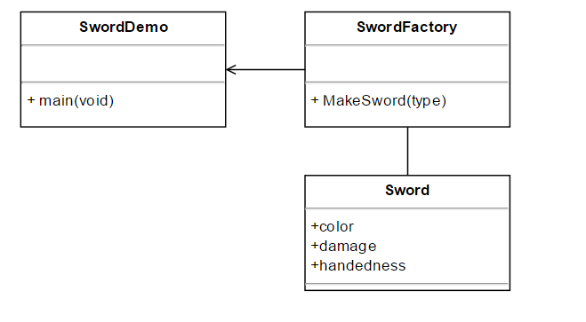
Factory
Notes:
<number>

Slide 15
Decorator Pattern
Problem:
How can we add functionality to a class at runtime instead of using inheritance at compiletime?
Example: See Java inputstream
Notes:
<number>

Slide 16
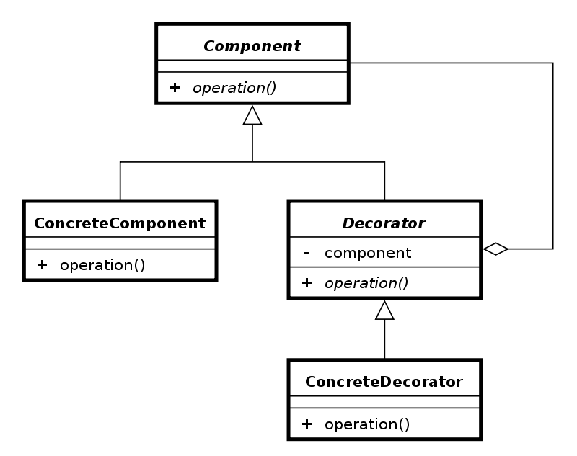
Decorator Pattern
Notes:
<number>

Slide 17
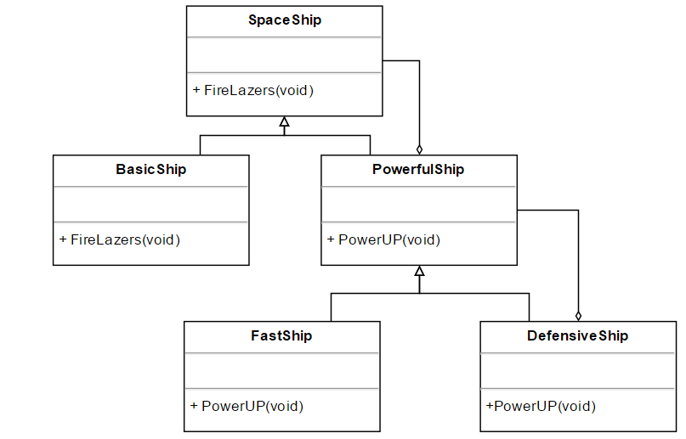
Decorator Pattern
Notes:
<number>

Slide 18
Adapter
Problem:
How can we make an old piece of code (eg. code taken from the internet) function with our current project?
Notes:
<number>

Slide 19
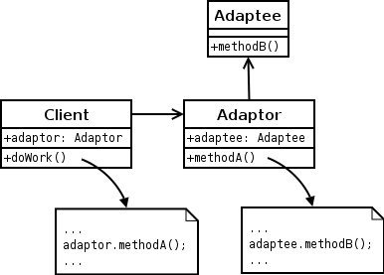
Adapter
Notes:
<number>

Slide 20
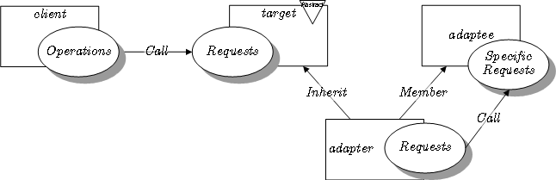
Adapter
Notes:
<number>

Slide 21
Singleton
Problem:
How can we make sure an object gets created once only during the program.
Bonus: if its created once only, can all other classes know and use this object?
Notes:
<number>

Slide 22
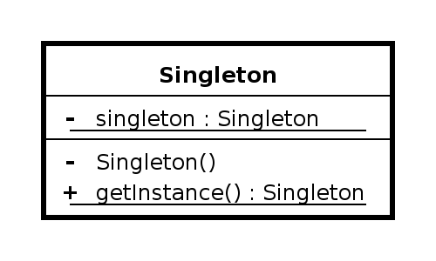
Singleton
Notes:
<number>

Slide 23
Singleton
Steps:
Add a static instance of the class
Make constructor Private
Make a static getter method for the instance
Notes:
<number>

Slide 24
Proxy
Problem:
How can we hide complexity of a class?
Notes:
<number>

Slide 25
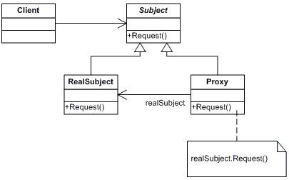
Proxy
Notes:
<number>

Slide 26
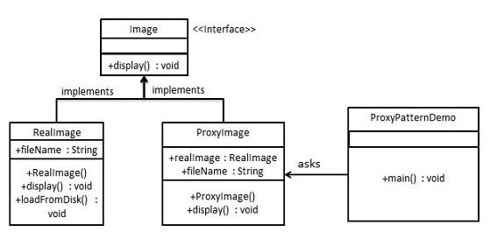
Proxy
Notes:
<number>

Slide 27
References
http://www.tutorialspoint.com/design_pattern/design_pattern_overview.htm
Factory: https://www.youtube.com/watch?v=ub0DXaeV6hA

